Slide 1



Supplementary Sensitivity Analysis
Accompanying the article:
National service evaluation of the quality of care for children and young people with congenital adrenal hyperplasia in the United Kingdom: survey responses from patients and clinicians
Assessment of any difference in response frequencies if patient or carer questions were answered within each of 3 six-month windows of a total of 18 months in which the questionnaire was open
(Please note, all clinician answers were received in the last 6 months of the questionnaire being open)

Slide 2
Service satisfaction
Accompanying the article:
National service evaluation of the quality of care for children and young people with congenital adrenal hyperplasia in the United Kingdom: survey responses from patients and clinicians
Assessment of any difference in response frequencies if patient or carer questions were answered within each of 3 six-month windows of a total of 18 months in which the questionnaire was open
(Please note, all clinician answers were received in the last 6 months of the questionnaire being open)

Slide 3
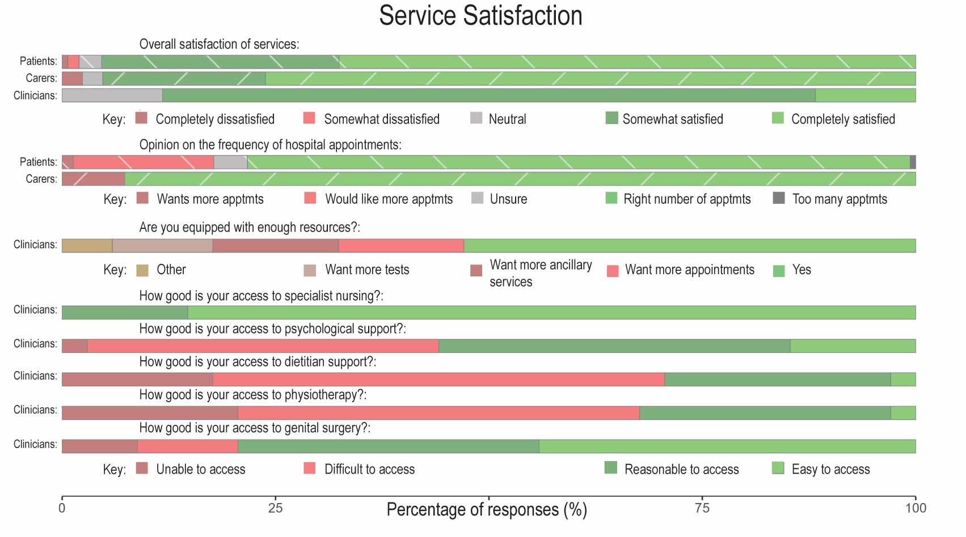
All responses

Slide 4
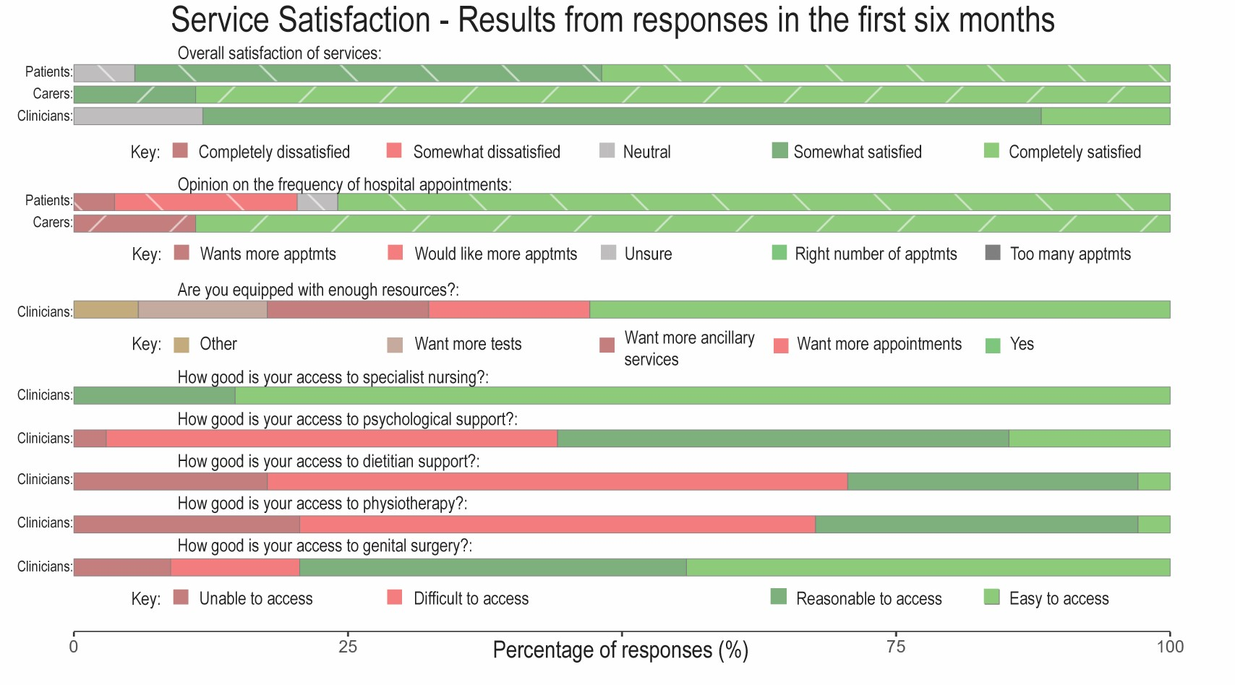
1st 6 months

Slide 5
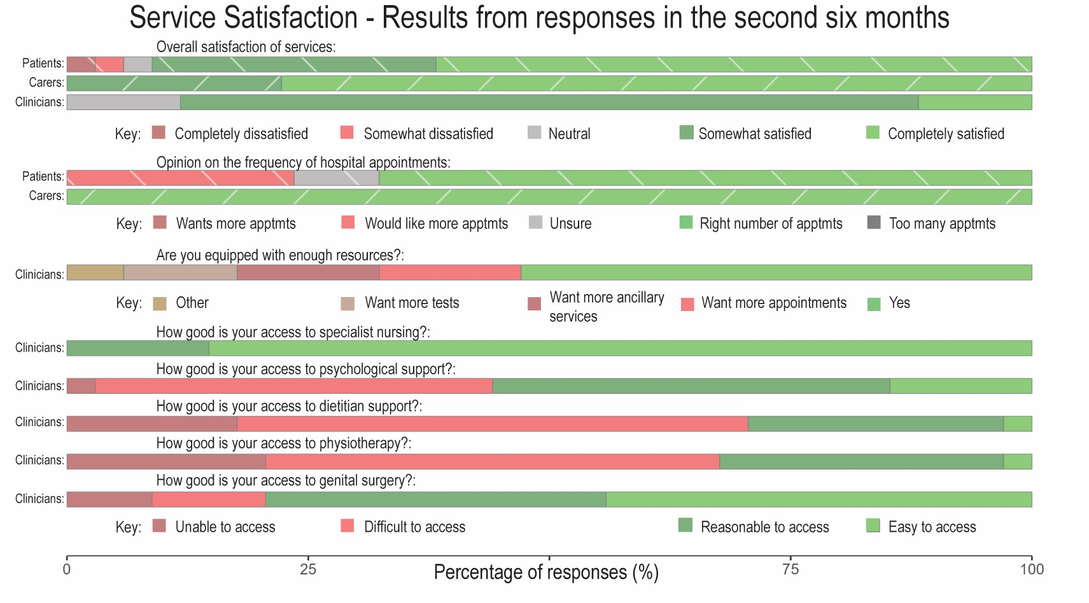
2nd 6 months

Slide 6
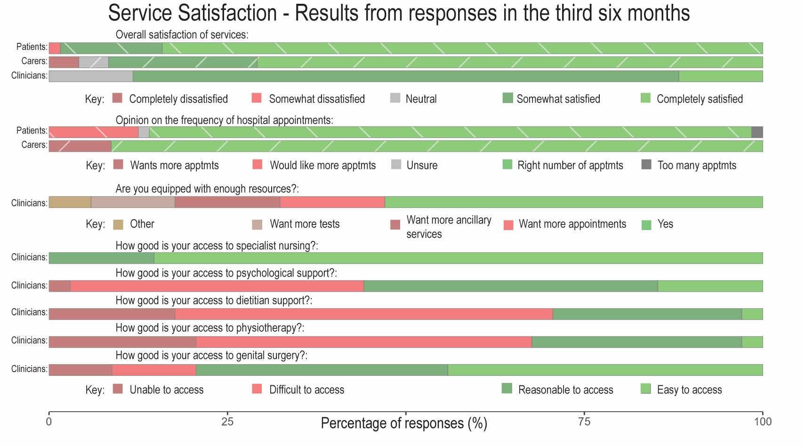
3rd 6 months

Slide 7
Similar responses to the total frequencies in each of the six month windows of responses

Slide 8
Metrics Assessed in Clinic
Accompanying the article:
National service evaluation of the quality of care for children and young people with congenital adrenal hyperplasia in the United Kingdom: survey responses from patients and clinicians
Assessment of any difference in response frequencies if patient or carer questions were answered within each of 3 six-month windows of a total of 18 months in which the questionnaire was open
(Please note, all clinician answers were received in the last 6 months of the questionnaire being open)

Slide 9
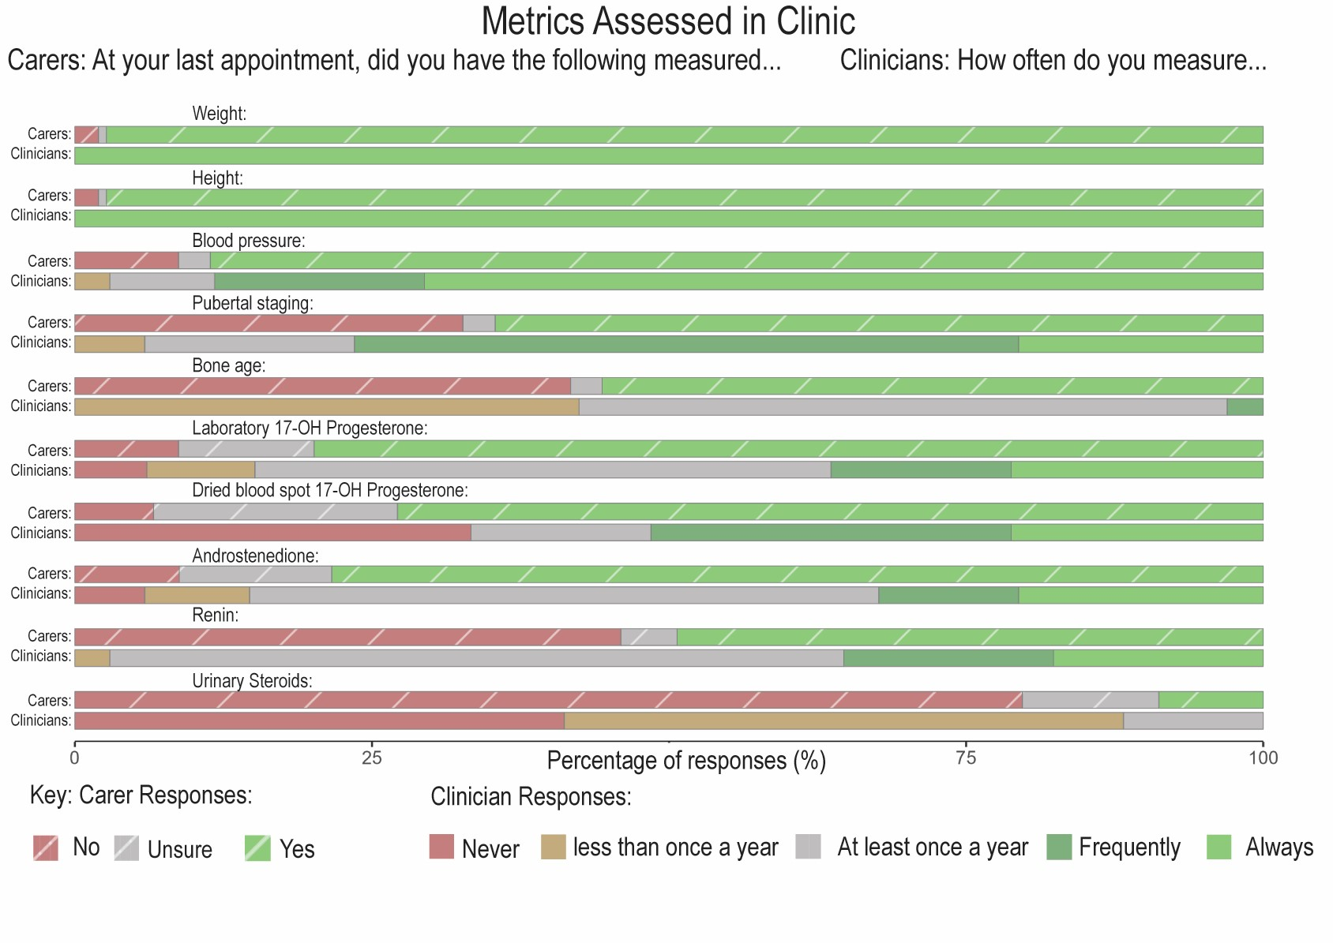
All responses

Slide 10
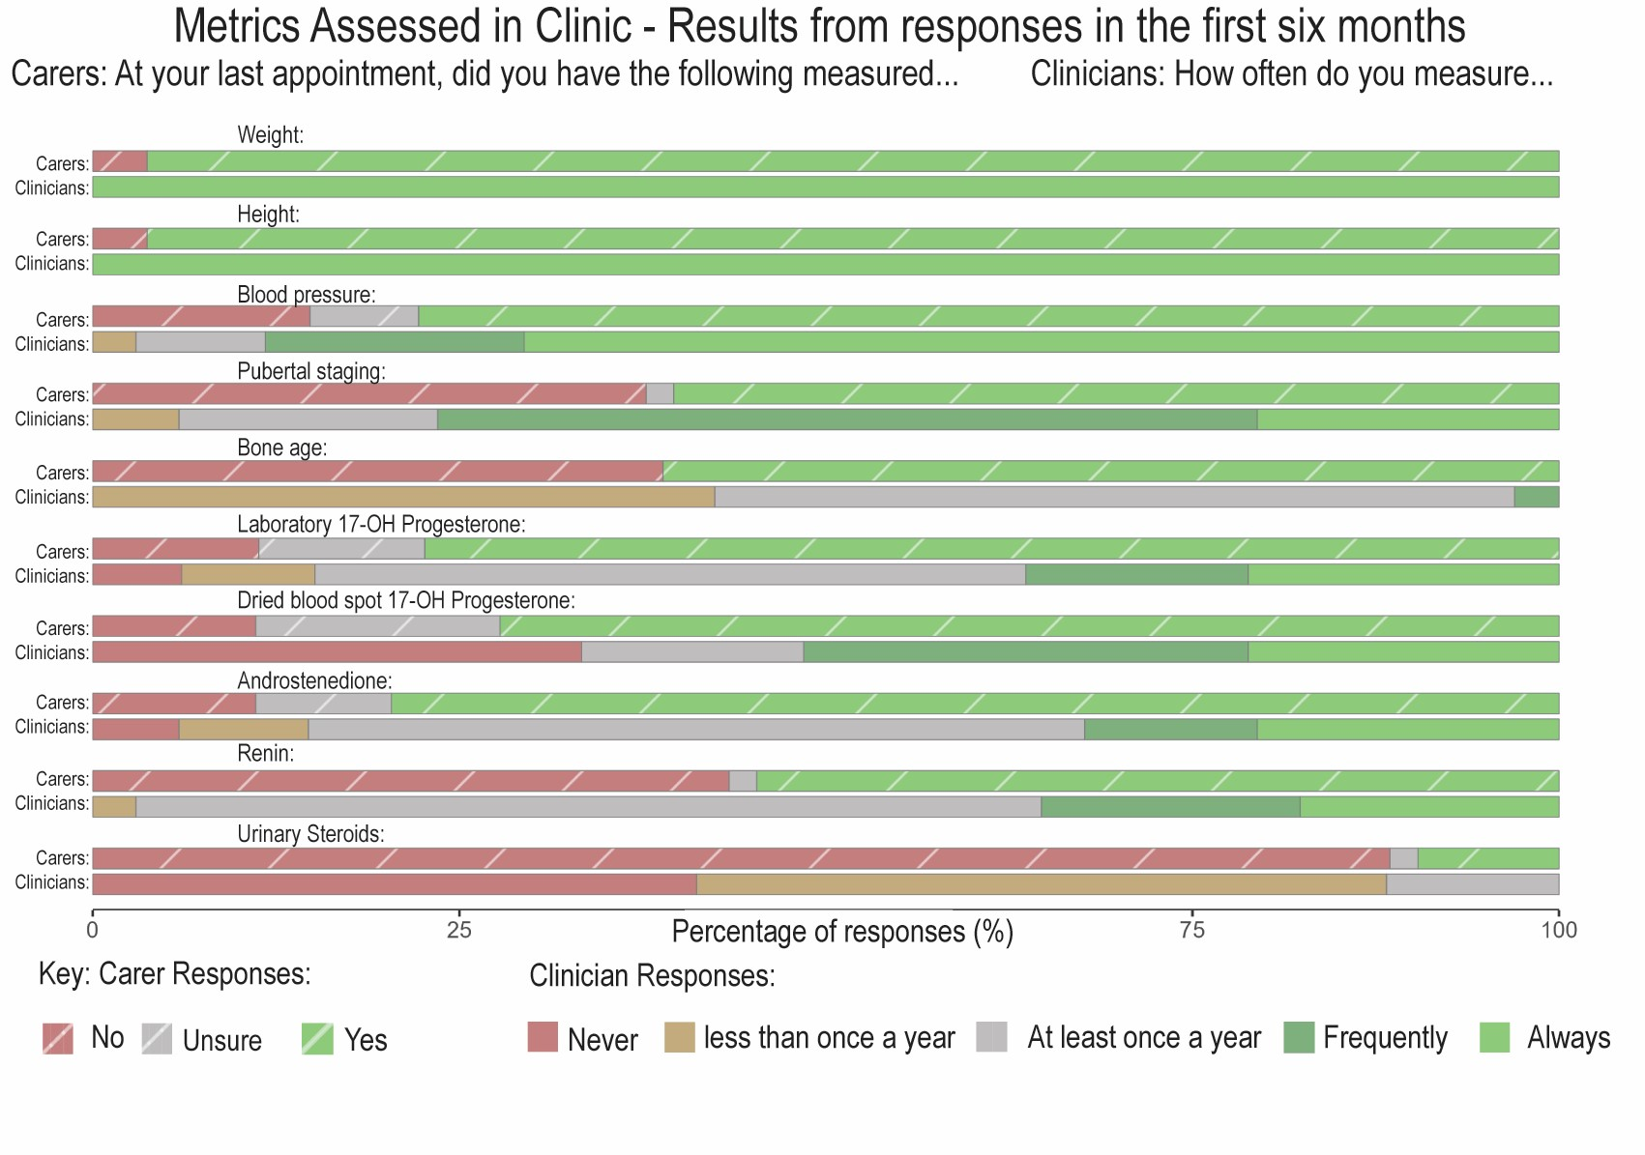
1st 6 months

Slide 11
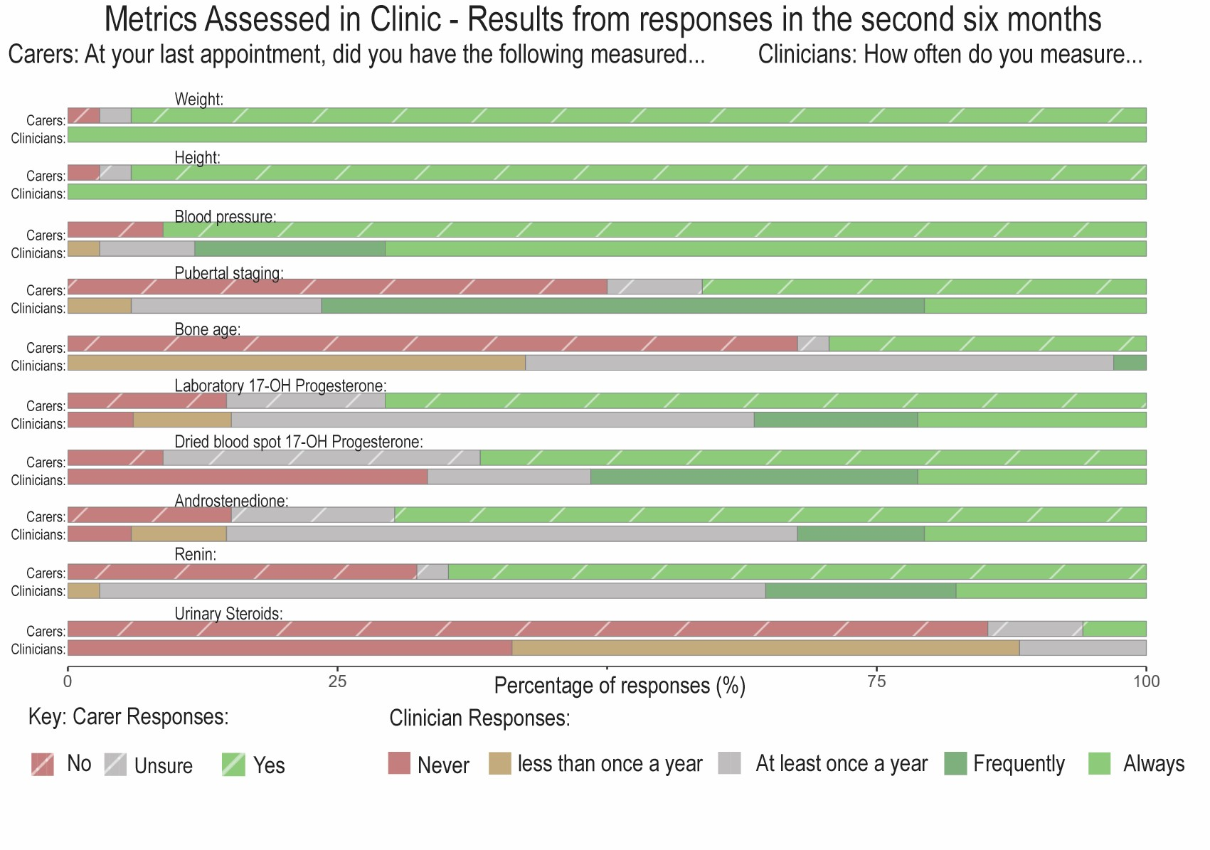
2nd 6 months

Slide 12
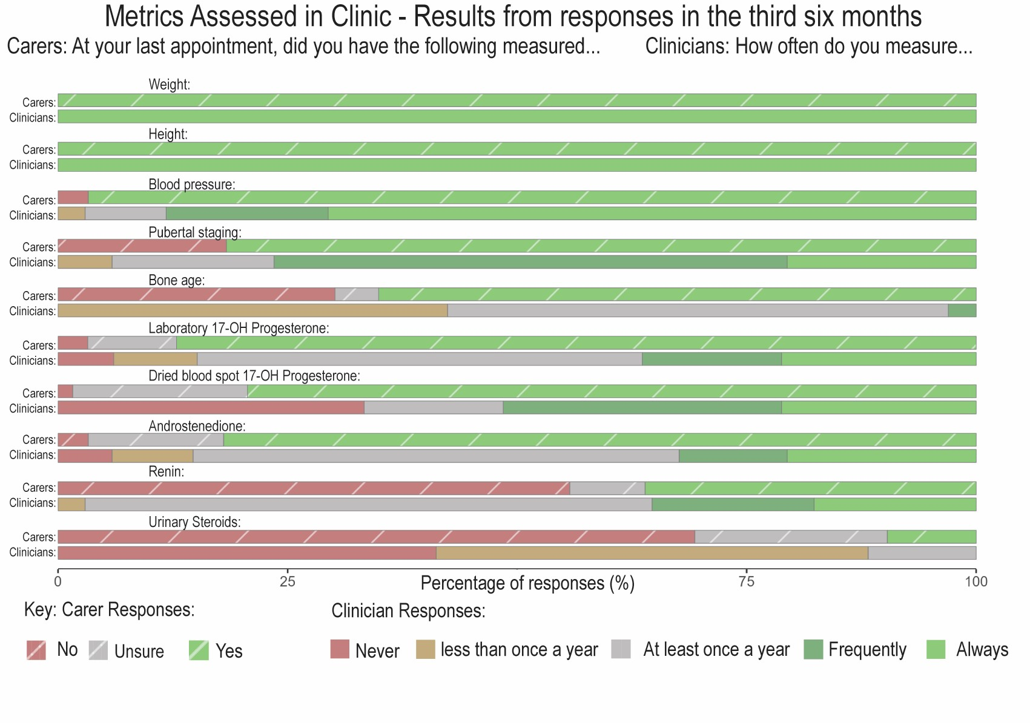
3rd 6 months

Slide 13
Similar responses to the total frequencies in each of the six month windows of responses

Slide 14
Discussions in clinic
Accompanying the article:
National service evaluation of the quality of care for children and young people with congenital adrenal hyperplasia in the United Kingdom: survey responses from patients and clinicians
Assessment of any difference in response frequencies if patient or carer questions were answered within each of 3 six-month windows of a total of 18 months in which the questionnaire was open
(Please note, all clinician answers were received in the last 6 months of the questionnaire being open)

Slide 15
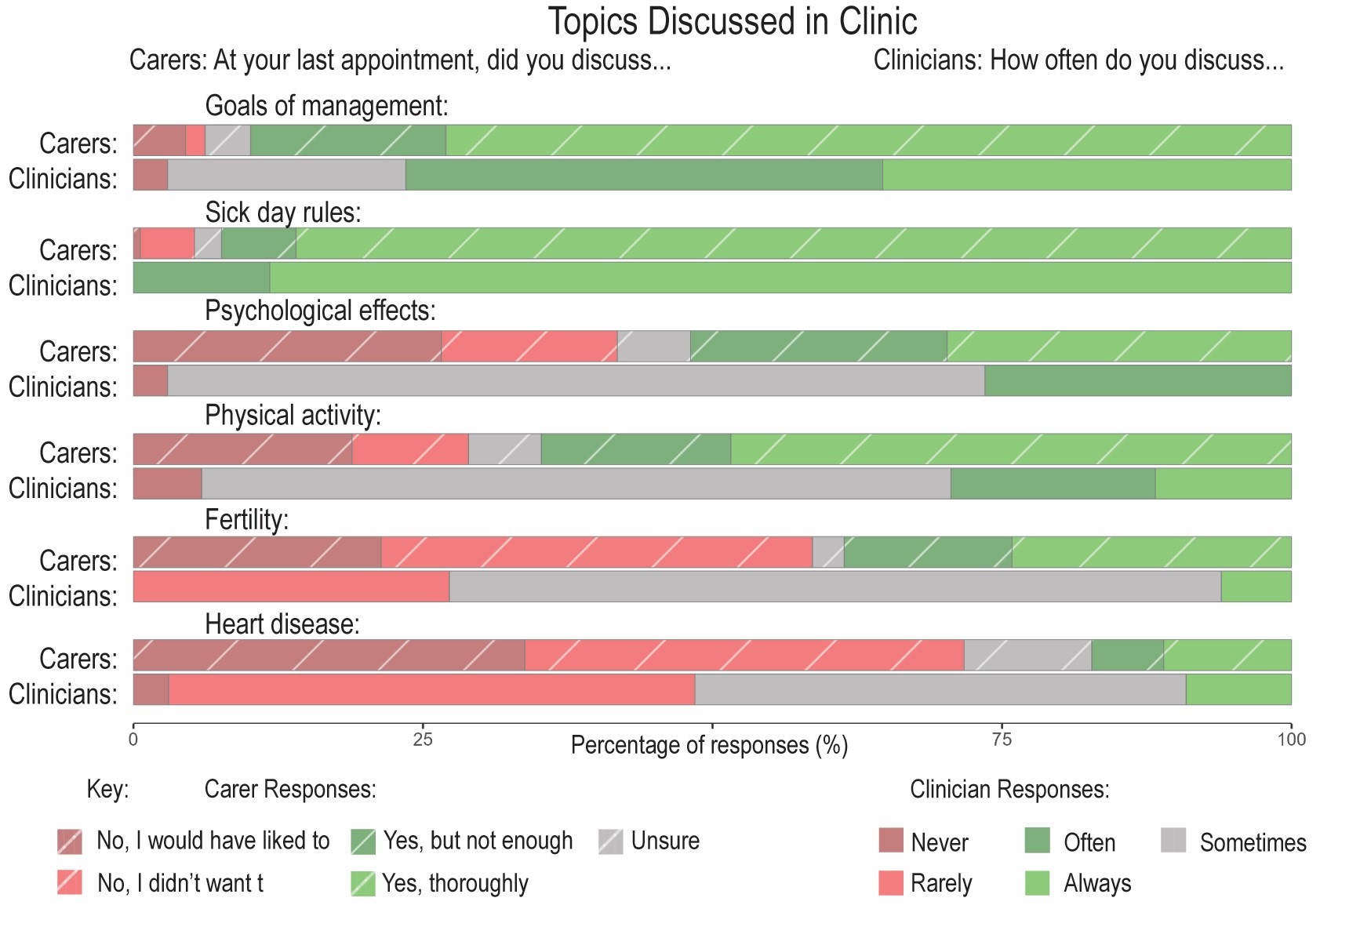
All responses

Slide 16
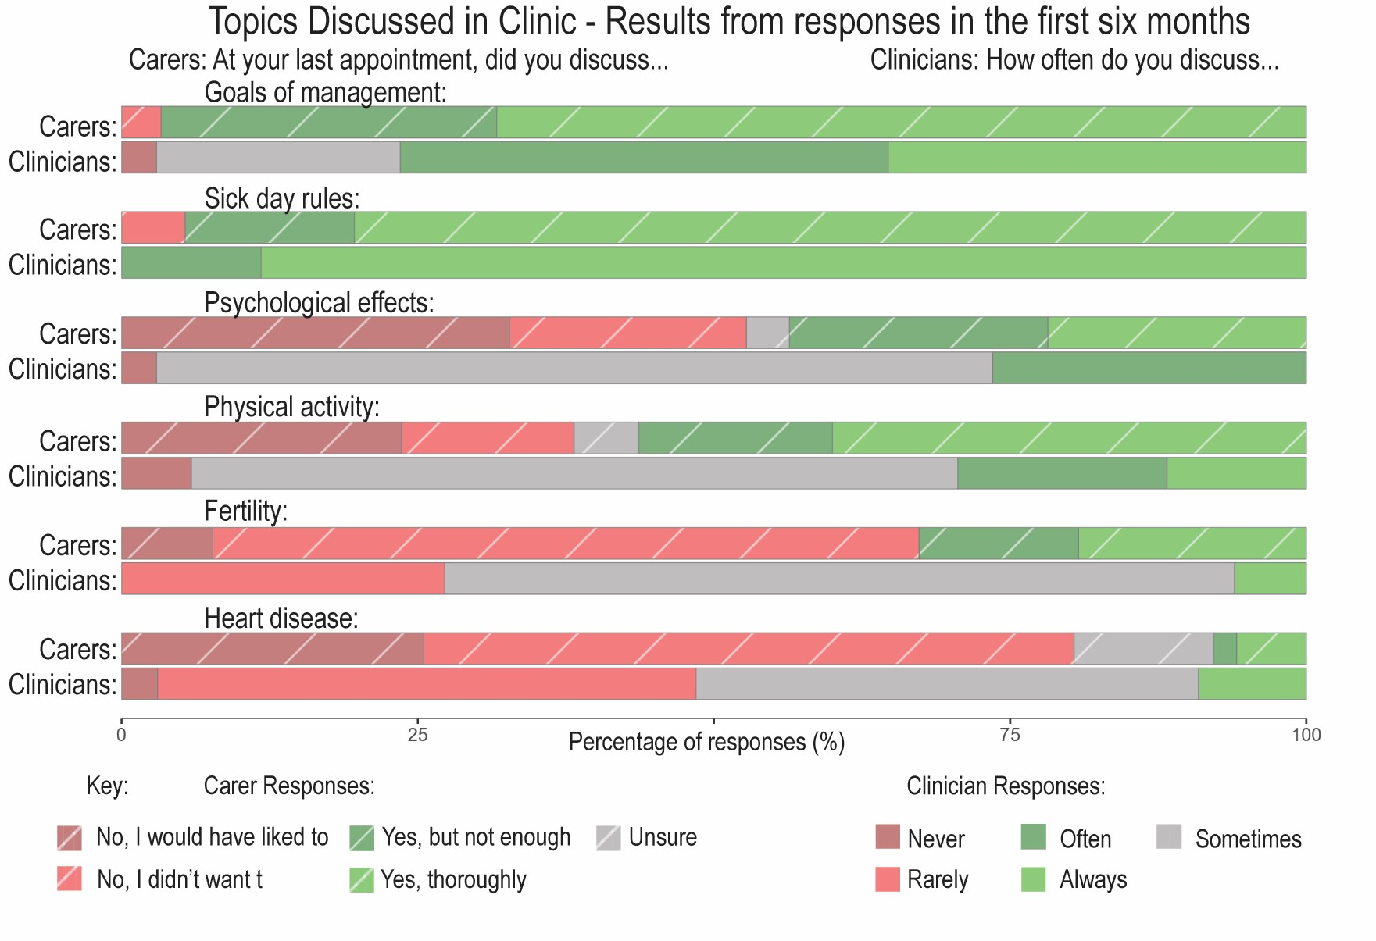
1st 6 months

Slide 17
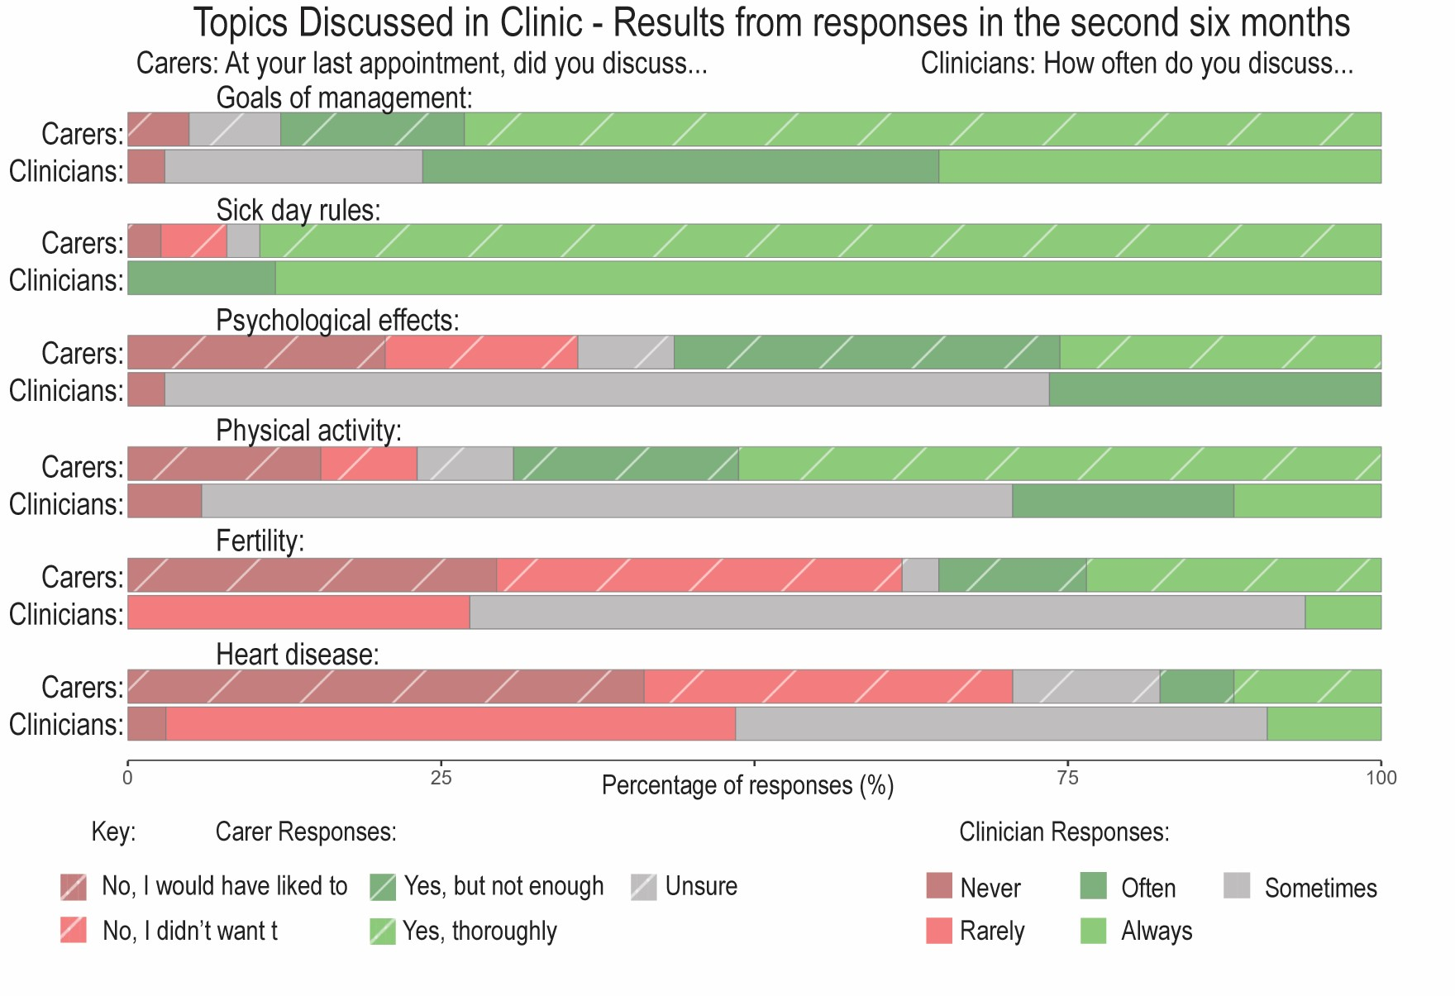
2nd 6 months

Slide 18
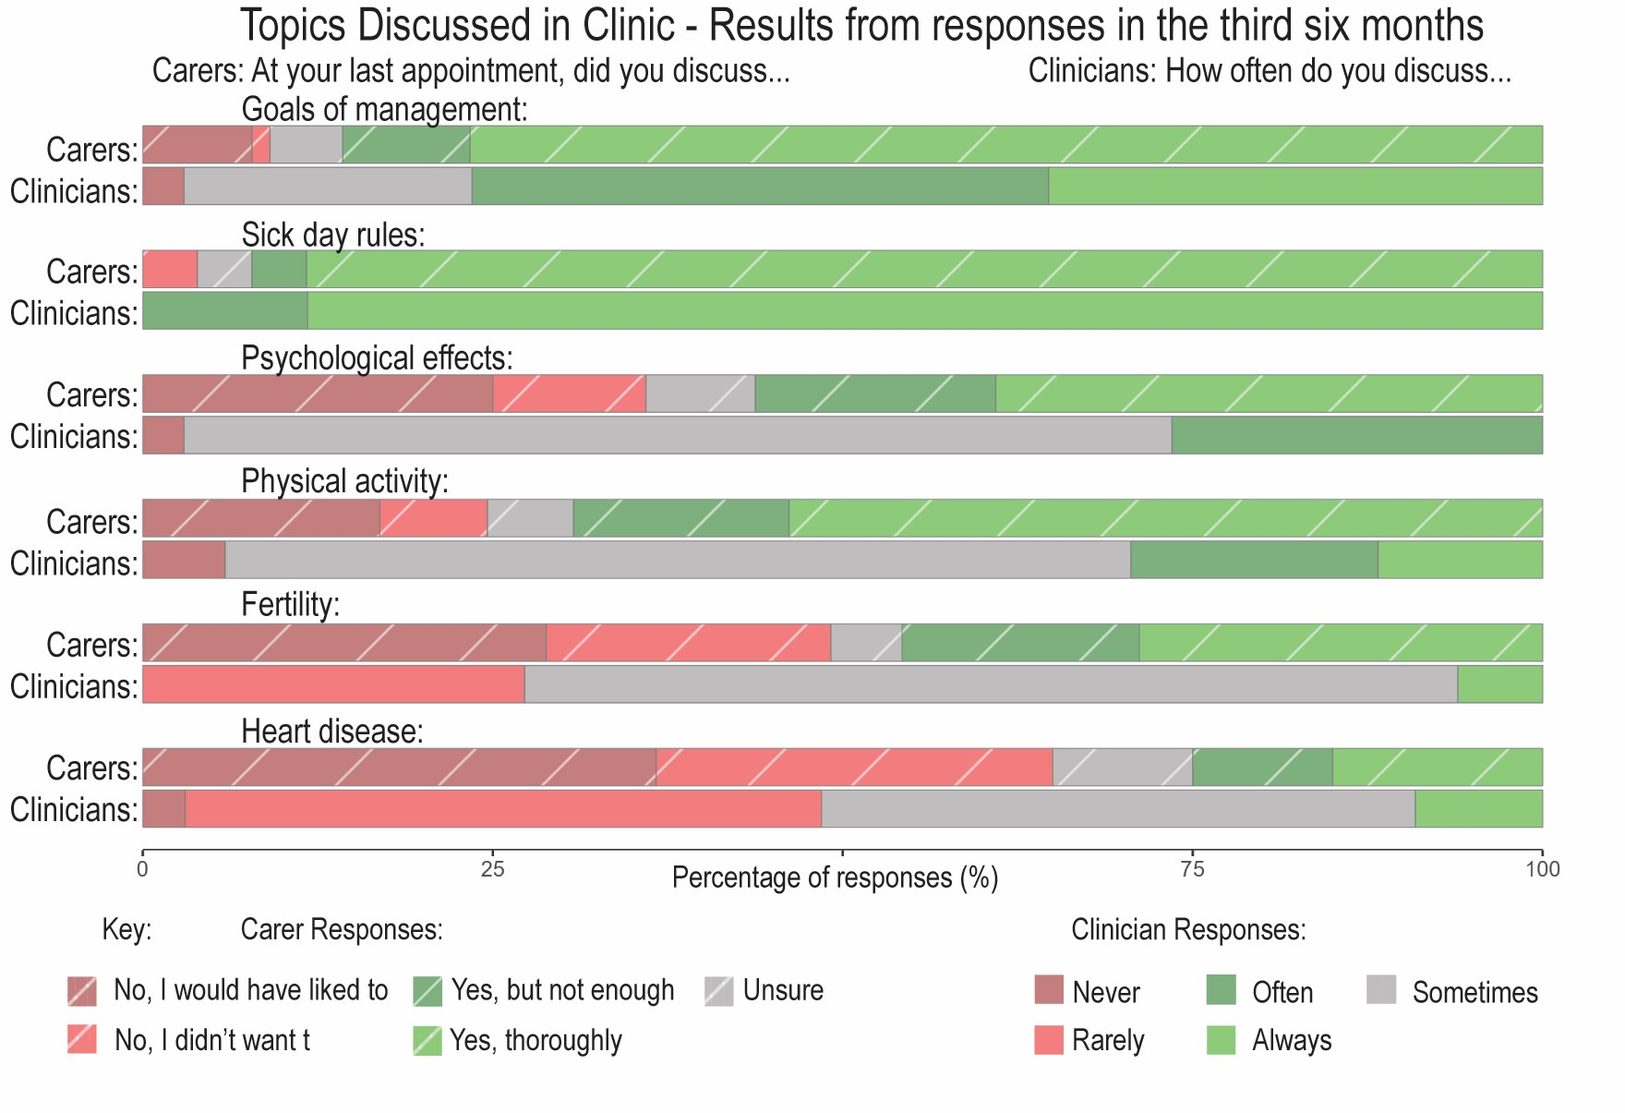
3rd 6 months

Slide 19
Similar responses to the total frequencies in each of the six month windows of responses

Slide 20
Patient education about CAH
Accompanying the article:
National service evaluation of the quality of care for children and young people with congenital adrenal hyperplasia in the United Kingdom: survey responses from patients and clinicians
Assessment of any difference in response frequencies if patient or carer questions were answered within each of 3 six-month windows of a total of 18 months in which the questionnaire was open
(Please note, all clinician answers were received in the last 6 months of the questionnaire being open)

Slide 21
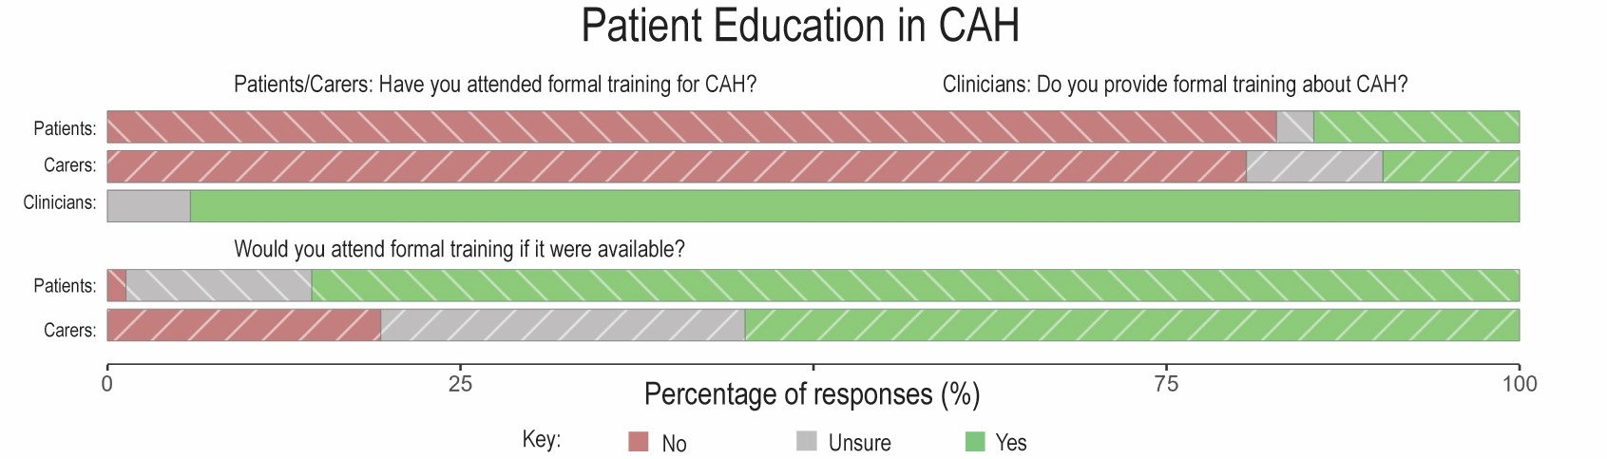
All responses

Slide 22
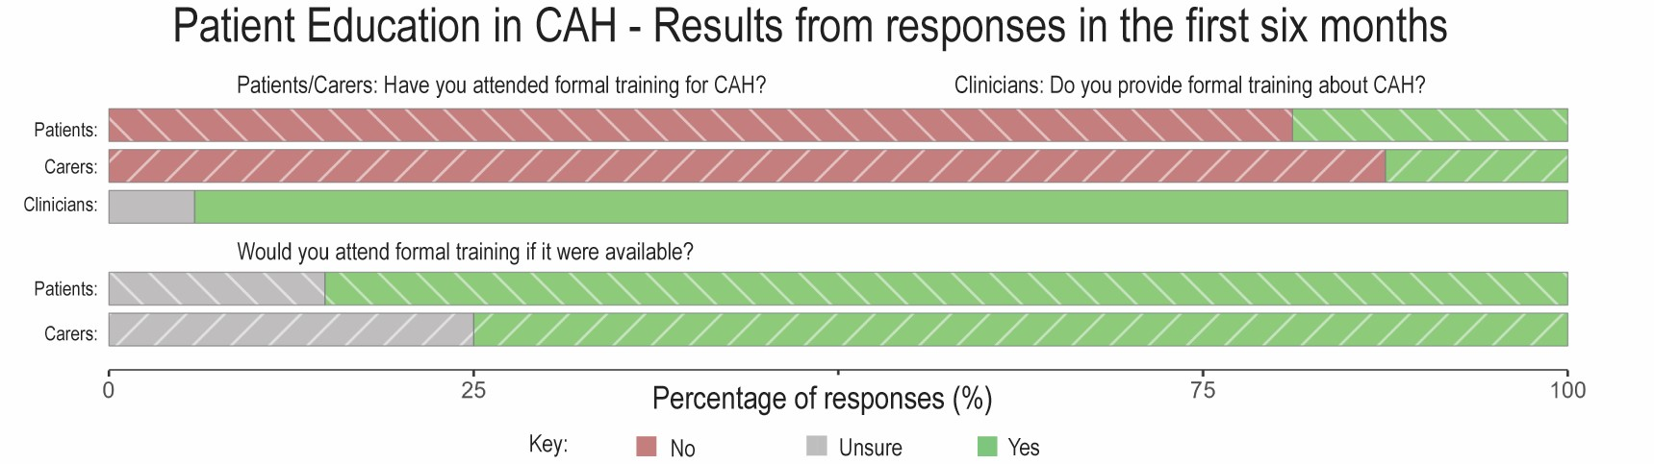
1st 6 months

Slide 23
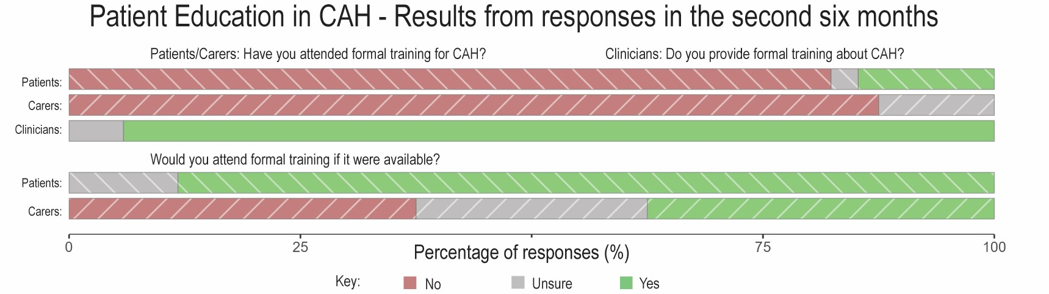
2nd 6 months

Slide 24
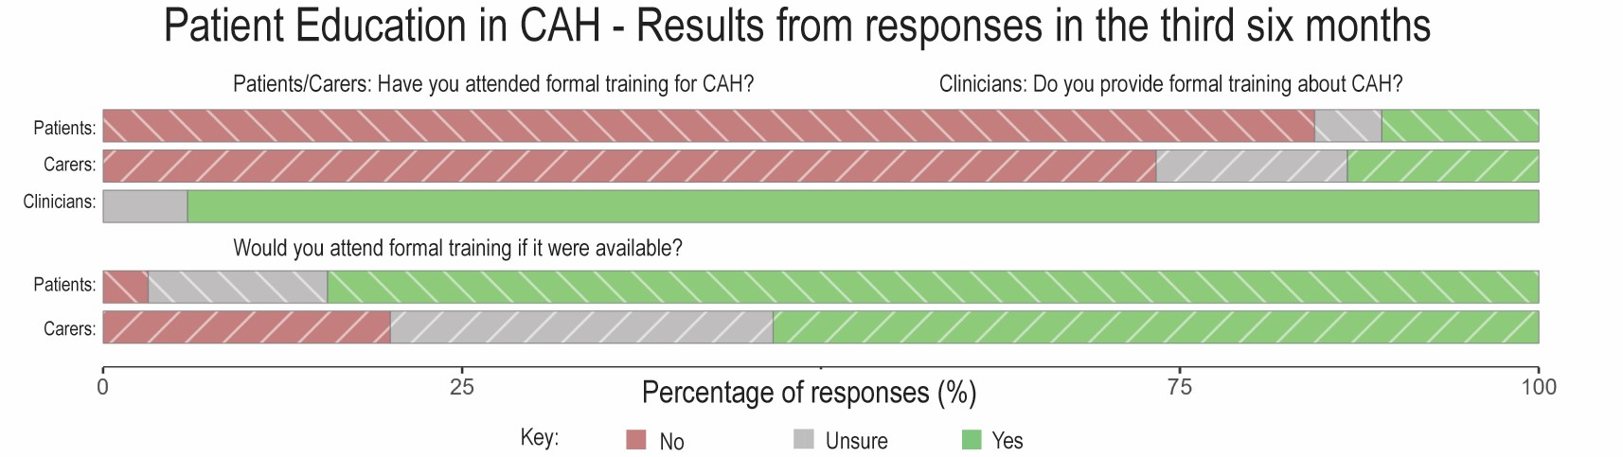
3rd 6 months

Slide 25
Similar responses to the total frequencies in each of the six month windows of responses

